Slide 1
Irrigation Machine Learning
Adrien Chabert

Slide 2






Slide 3


200’000 km³ of fresh water
Notes:
200’000 km3 of fresh water on earth
2/3 for irrigation
Decrease water consumption of 20%-25%

Slide 4
Research of Literature
Collect Data
Integration of Machine Learning Algorithm
Test our result
Create a watering plan

Slide 5
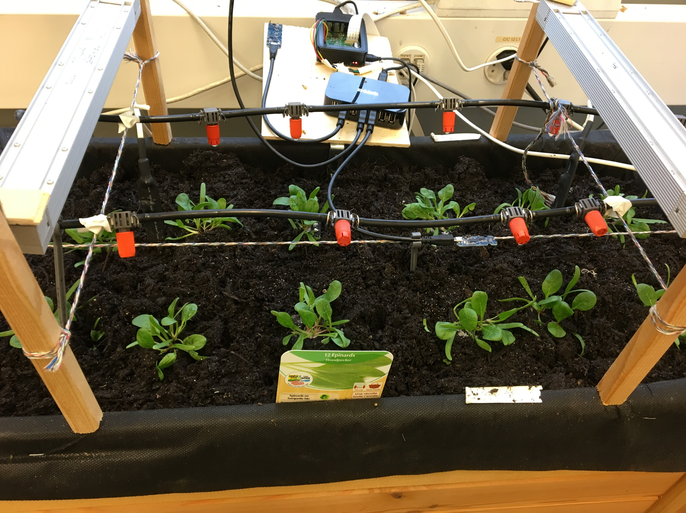
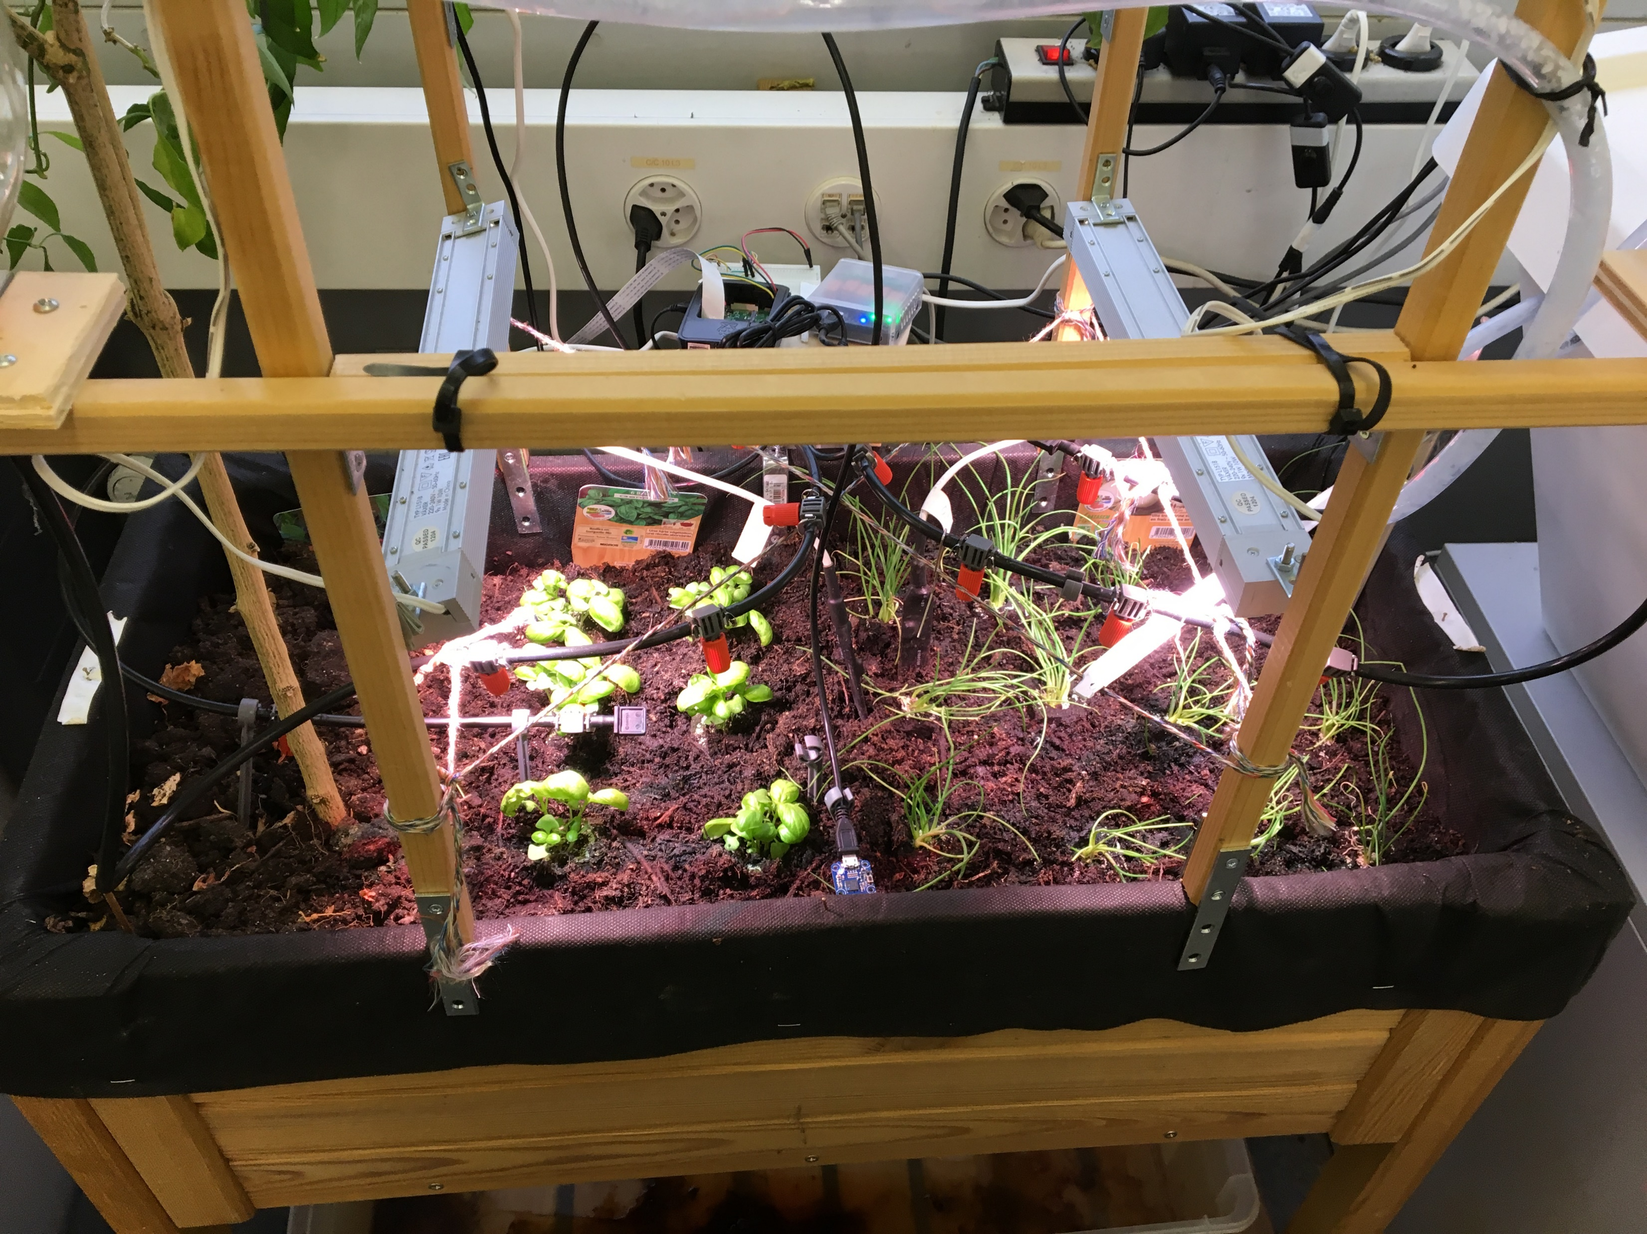
Planting
Basilic, onion, spinach

Slide 6
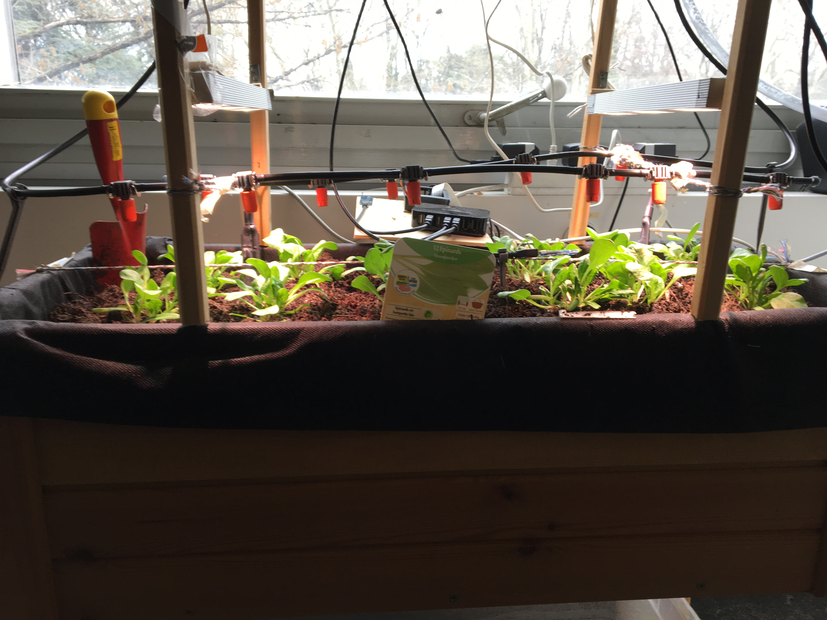
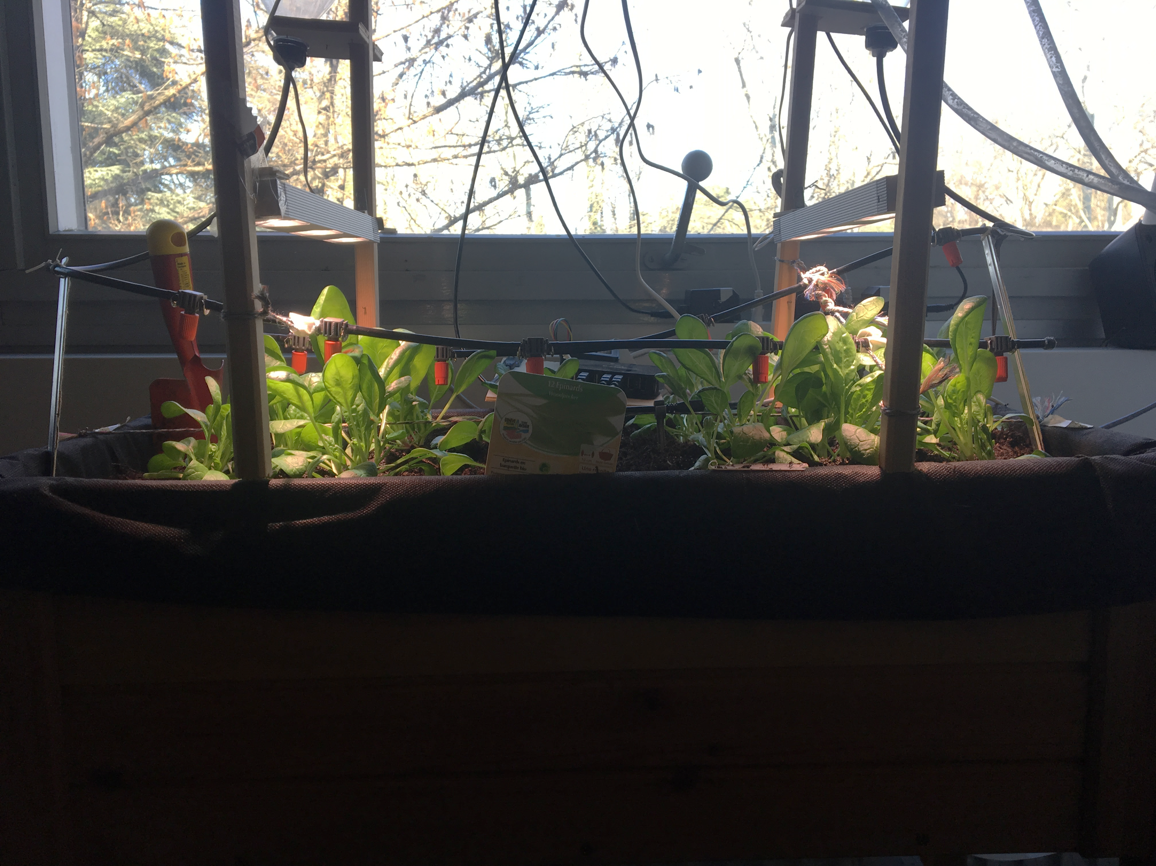
13 mars
20 mars

Slide 7






Slide 8


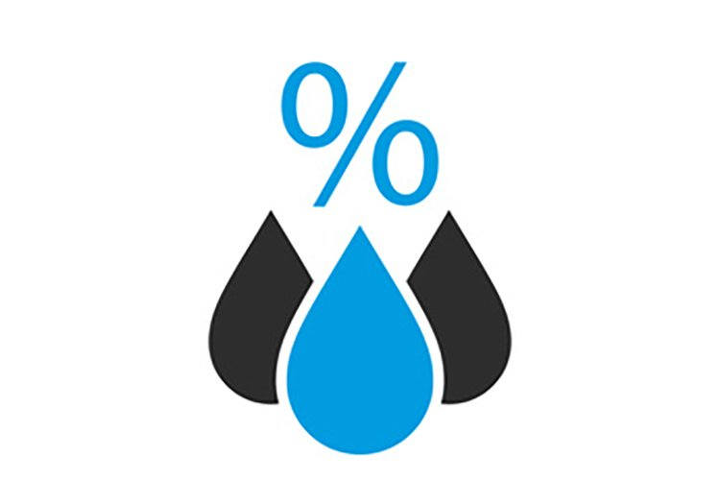
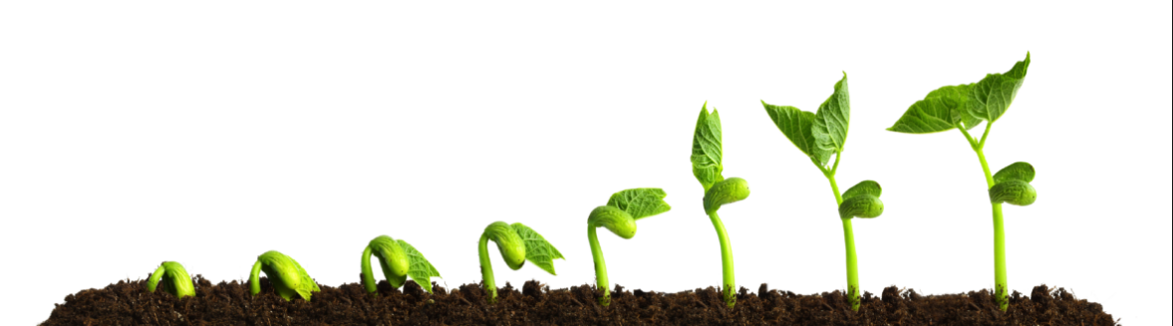
Notes:
Le vent impacte également mais pas dans notre cas

Slide 9
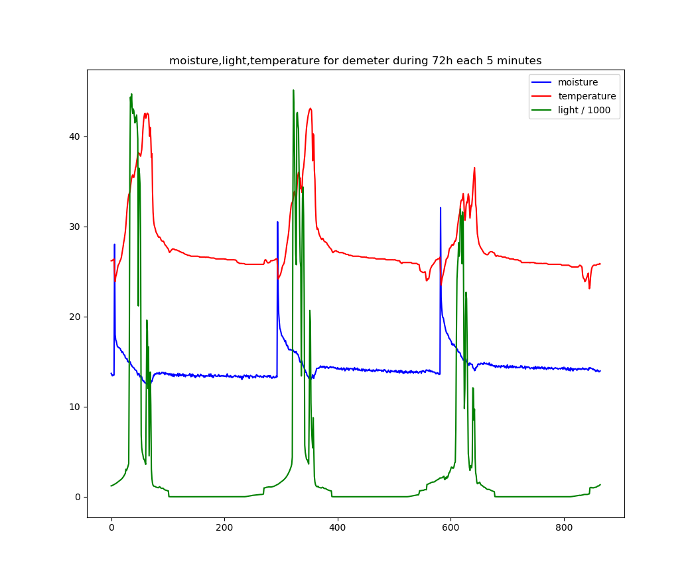
Notes:
Lumière : Lux . 10 = 10k Lux

Slide 10
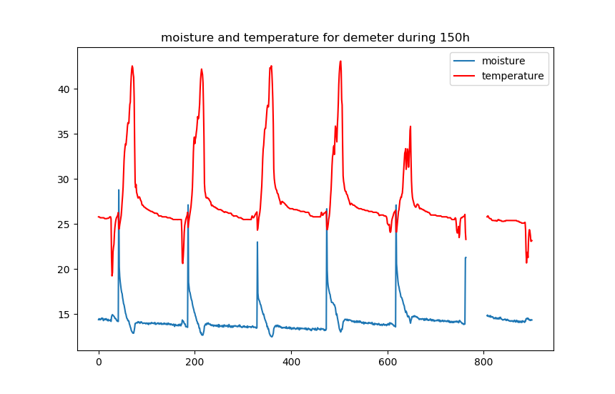
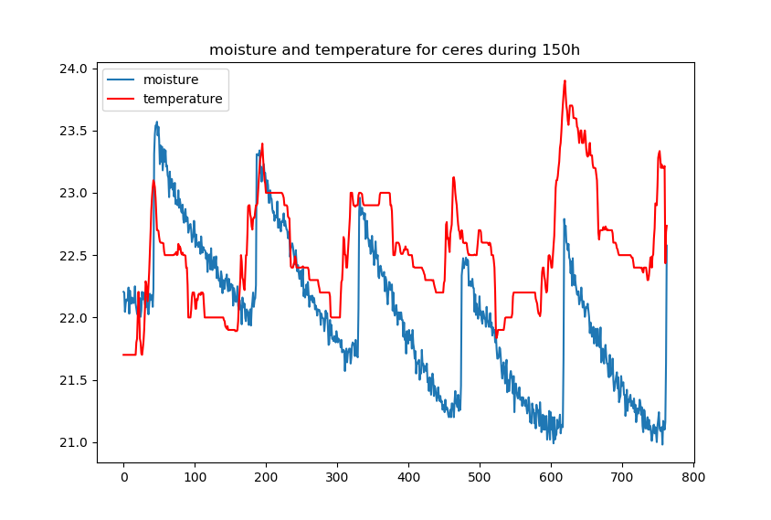

Slide 11
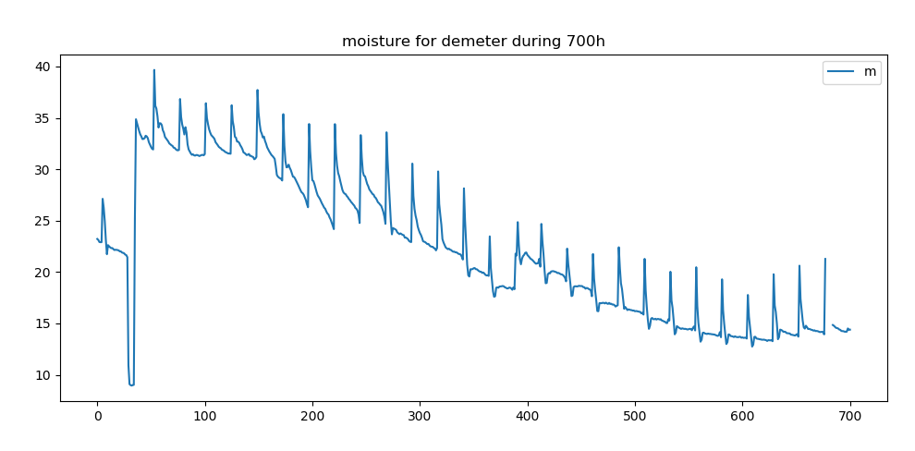
Moisture
porcent

Slide 12
Date | Ceres | Demeter | Autre
6-Mar | 10 s/j | 10 s/j
13-Mar | 10 s/j | 10 s/j
20-Mar | 10 s/j | 10 s/j
27-Mar | 20 s/j | 15 s/j
3-Apr | 20 s/j | 15 s/j | Full watering
10-Apr | 50 s/2j | 30 s/2j
17-Apr | 30 s/j | 10 s/j
24-Apr | 30 s/j | 10 s/j
1-May | 40 s/j | 20 s/2j | Full watering
8-May | 20 s/0.5j | 20 s/j
15-May
22-May |  |  | Full watering
29-May
5-Jun |  |  | Full watering
12-Jun
19-Jun |  |  | Full watering
26-Jun
3-Jul
10-Jul
Watering Plan

Slide 13
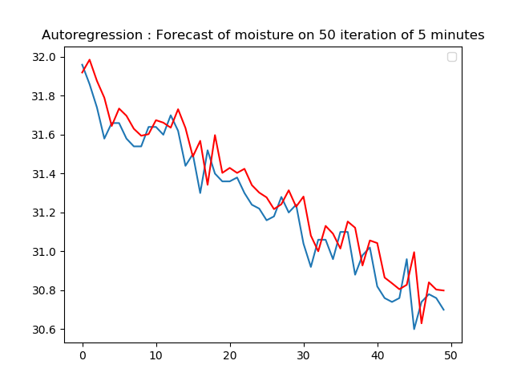
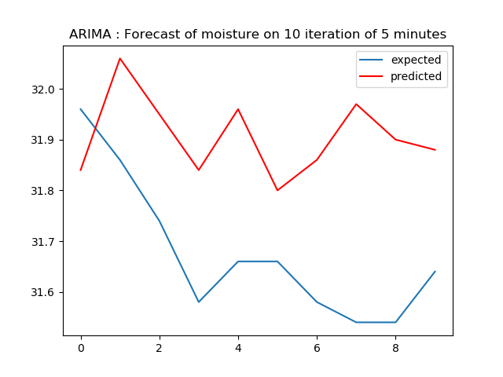
Test_MSE : 0.017
Test_MSE : 0.073
Notes:
ARIMA : Autoregressive integrated moving average
Non stationarity,
AR : Autoregression
MA : linear regression error
I for integrate

Slide 14
Position of the humidity sensor
Defective Captor
Pandas and Matplotlib not working on Jupyter
Difficulty to implement ML
Lack of knowledge of ML

Slide 15
Planning for the next 3 weeks
REALLY Finish the research of Literature
Finish Research about Machine Learning algorithm
Finish Implementation of a first easy ML algorithm
ARIMA
Least Squares Multiple Linear Regression
Notes:
Ou Bayesian learning machine approach for Regression

Slide 16
Project Planning

